Slide 1
Where Business Belongs…

Slide 3
Lesley Robinson
Head of Business Support
Cumbria Chamber of Commerce/Cumbria Business Growth Hub

Slide 4
What has Cumbria Business Growth Hub been delivering in the last past 12 months?
ERDF Business Start-Up Support programme
ERDF Cumbria Business Growth Hub
DWP New Enterprise Allowance Scheme – end of project activity

Slide 5
New contracts/successful bid submissions
Barrow Business & Enterprise Support project – CLEP delivery
The Business Hub – CLEP delivery
UK SPF yr 1 Allerdale & Copeland
Asylum seeker/refugee business start-up

Slide 6
What’s gone well?
Successful completion of ERDF delivery
To date, the Growth Hub has worked directly with more than 8,700 businesses, with around 3,000 benefitting from intensive assistance. This has created or safeguarded 6,600 jobs and generated an estimated £330m GVA.
New programmes piloted
Delivery of 2 SPF funded projects in 3 months
Over 30 businesses supported in Allerdale/Copeland
Refugee/asylum seeker start-up project – 18 contracted,31 supported

Slide 7
What’s gone well?
Free webinars delivered
Food & Drink activity
Supply chain development – Sizewell C, Rolls Royce SMR, Sir Robert McAlpine
Constant conversations with people who want to work with and for us

Slide 8
High Performance Flow
Participants overall High Performance FLOW score jumped 16%, from 62% pre course to 78% post course, suggesting that the course has had a significant impact.
Dimension 1: Be the Best This dimension demonstrates the highest level of impact, jumping 23%, from 52% pre course to 75% post course
Dimension 2: Be Disruptive Participants overall score in this dimension jumped considerably by 18%, from 62% pre course to 80% post course. This demonstrates that participants capacity to innovate, change and apply disruptive thinking has significantly increased.
Dimension 3: Be brave The overall Be Brave score jumped 7%, from 73% pre course to 80% post course suggesting that participants already demonstrated relatively strong characteristics and behaviours in this dimension upon joining the course.

Slide 9
High Performance Flow
''Before attending the workshop, I was fed up of the business, I'd fallen out of love with what I'd built. The worst part, I didn’t even realise it!'' ''The workshops, helped me realise what was wrong and how to fix it. The advice given was excellent. Thankyou Colin & Mike'' Mike Rudkin – Owner, Cumbria Life Castings Ltd
“I'd highly recommend the High Performance FLOW workshop and have already done so to numerous colleagues and clients. The pace of the workshops and the variety of topics covered was at a level that was easy to relate to your own organisation and industry.” Lyndsay Gray – CEO, Natterjack Marketing
“One of the best and most useful business courses I have ever attended.” Tracey Lindsay –Owner, Manor Barn Organics

Slide 10
High Performance Flow
I would highly recommend Colin and the High Performance FLOW course. The course was extremely well designed and delivered. The content of the course gave fantastic insight to the reasoning behind our own and others behaviours and gave insight to how we can make these differences work! The person / group centred approach allowed for a completely bespoke programme allowing us all to take so much away from each of the sessions. The guest speakers were all well respected and high achieving individuals which really helped us gain useful insight and ideas we could take back and apply in our own settings. Working along side other business owners, openly discussing our barriers and concerns and everyone then contributing as a team to offer tips, solutions and a direction for change was extremely powerful and highly motivating. The follow up one to one sessions then allow full focus on my own personal and business direction and helped embed all that had been discussed and action planned from the group sessions. Kerri Black – Director, FirPress Ltd

Slide 11
Two Day Business Deep Dive
Group diversity-great. Group size is great, networking and group problem solving was unexpected but really added to the experience.
Everything: The balance between ‘play’ and canvas work
It was really thought provoking. Every section was well balanced. One of the best courses I have been on.
It was useful to have the evening for further conversations.
Encouraged to think outside of normal. Massive benefit with a great mixture of professionals and qualities.
Informative. Think out of the box. Worked for me!
The LEGO: clever way to use it and a new market for LEGO

Slide 12
What next?
Westmorland & Furness UK Shared Prosperity Funding submissions:
- start-up and existing business
- Rural business grants and support
- De-carbonisation bid with Cumbria Action for Sustainability – grants and green growth hub
Cumberland calls for UK Shared Prosperity Funding
Continuing delivery of CLEP contracts – Barrow and The Business Hub
Merging of Chamber Commercial Training and Cumbria Business Growth Hub
Conference Cumbria

Slide 13
What next?
Keeping an eye out for other future funding
Developing further partnerships & delivery options
Delivering business support which is relevant, what businesses need, inclusive, flexible and simplifies the business support landscape

Slide 15
AGM
June 2023

Slide 16
Eve Halliday
Head of Commercial & Business Growth

Slide 17
Membership numbers

Slide 18
Chamber Membership

Slide 19
Member
Services

Slide 20
Chamber Membership – Price increase
Costs based on employee banding:
Prices are subject to VAT
Sole Trader: £175
Employees 2 – 5: £255
Employees: 6-9: £355
Employees: 10-24: £455
Employees: 25-99: £555
Employees: 100-249: £655 / Directors Club included (Health extras is charged as a bolt on 23p per employee per month)
Employees: 250-499: £755 / Directors Club included(Health extras is charged as a bolt on 23p per employee per month)
Employees: 500+: £855 / Directors Club included (Health extras is charged as a bolt on 23p per employee per month)
Patron: £1,500 – See ‘Patronage package’ information

Slide 21
Chamber Membership – Price increase
Costs based on employee banding:
Prices are subject to VAT
Sole Trader: £175
Employees 2 – 5: £255
Employees: 6-9: £355
Employees: 10-24: £455
Employees: 25-99: £555
Employees: 100-249: £655 / Directors Club included (Health extras is charged as a bolt on 23p per employee per month)
Employees: 250-499: £755 / Directors Club included(Health extras is charged as a bolt on 23p per employee per month)
Employees: 500+: £855 / Directors Club included (Health extras is charged as a bolt on 23p per employee per month)
Patron: £1,500 – See ‘Patronage package’ information

Slide 22
Chamber Membership
HR/ employment law Helpline
H&S advice Helpline
Tax & Vat advice Helpline
Legal advice Helpline
HR tribunal cover
Online Library of HR/ Employment template documents
Online Library of H&S template documents
Online Library of Legal template documents
Legal expenses insurance with aggregate limit of £1,000,000 of cover, excess free
Areas of cover:
Employment Disputes
Health & Safety Prosecutions
Tax Protection – dealing with a HM revenue & Customs full enquiry
Criminal Prosecution Defence
Statutory License Protection
Jury service allowance (cost of insured or an employees salary)
Property Disputes
Data protection
Personal injury (Director or employee)
Motor disputes
Wrongful arrest defence
Discounts on training
Discounts on export documentation
Discounts on events
Members newsletter
Opportunity to shape into policy and lobbying activity
Access to discounted member services
Utility Bill Review (Free/ no obligation)
Access to Chamber finance finder
Up to 67% discount on AA cover for fleet or vehicles used for ‘business use’
Discounted foreign exchange services
Discounted employee healthcare plan/ cashback plan
Option to join The Directors Club £100 + VAT per annum, membership is included for 100 employees + (access to directors club newsletter and invite to at least 1 event per annum)

Slide 23
Chamber Membership
Available from 1st April 2023
Healthy Extras Staff Rewards Portal – savings
Healthy Extras – Employee 24 hr advice and information helpline
*Healthy Extras - Included in membership bands up to 99 employees, 100+ employees requires a bolt on for 23p per employee per month.
Employee wellbeing portal
Members Directory – you control if you list
Members news area –upload your own news stories
Members Events calendar – upload your own events to promote to other Members
Members Marketplace – upload exclusive offers for other Chamber Members
121 Meeting covering (Free) – Understand services, Review compliance with an Expert, Compare services to make sure you save money.
Cyber Security Review (Free/ no obligation)
IT Systems Review (Free/ no obligation)
Merchant Services Review (Free/ no obligation)

Slide 24
Chamber Membership
Patronage Package
Many of our members have let us know that Chamber Membership is one way for them to engage with businesses and the local community from a CSR perspective. With this in mind their requirements are slightly different to some of our other members, which is why we have created the Patronage Package.
What’s included:
Everything detailed on the Membership – What’s included page with the exception of the ‘Healthy extras’ which can be purchased as a bolt on.
Power 40 membership (Invite only events for the biggest businesses and patrons)
Directors Club membership
Business Logo on Chamber web page as a Patron
Contribution to providing the employee wellbeing portal for all members
Contribution to Cumbria Conference and sponsorship recognition on all collateral with stand space
Option for a CSR statement detailing your contribution to local businesses
We are happy to discuss other options based on specific requirements for a bespoke package.
Our Patrons:

Slide 25
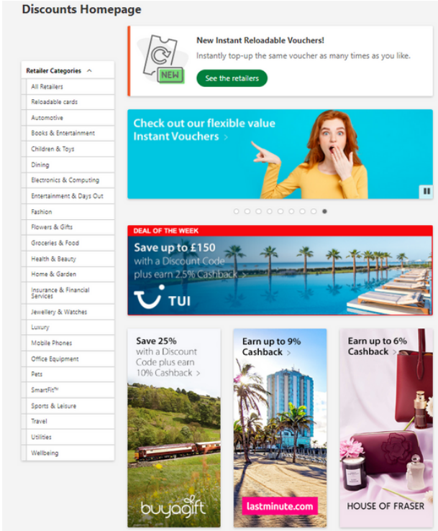
Chamber Healthy Extras
Benefits included for those in the ‘up to 100’ employee bands.
Giving something to your employees
What’s included?
Discount & rewards Portal
Employee 24 hr advice & information helpline
More than 100 employees?
23p per employee per month.

Slide 26
Chamber IT Solutions
IT Support
IT review & Cyber security review.
IT systems review, what’s included?
Visit to business premises
Review of:
Hardware
Backups
Cyber security
Any current IT issues
Full report & recommendations
Cyber Security review, what’s included?
Assessment of current setup
Identification of shortfalls
Full report & recommendations
Provided by

Slide 27
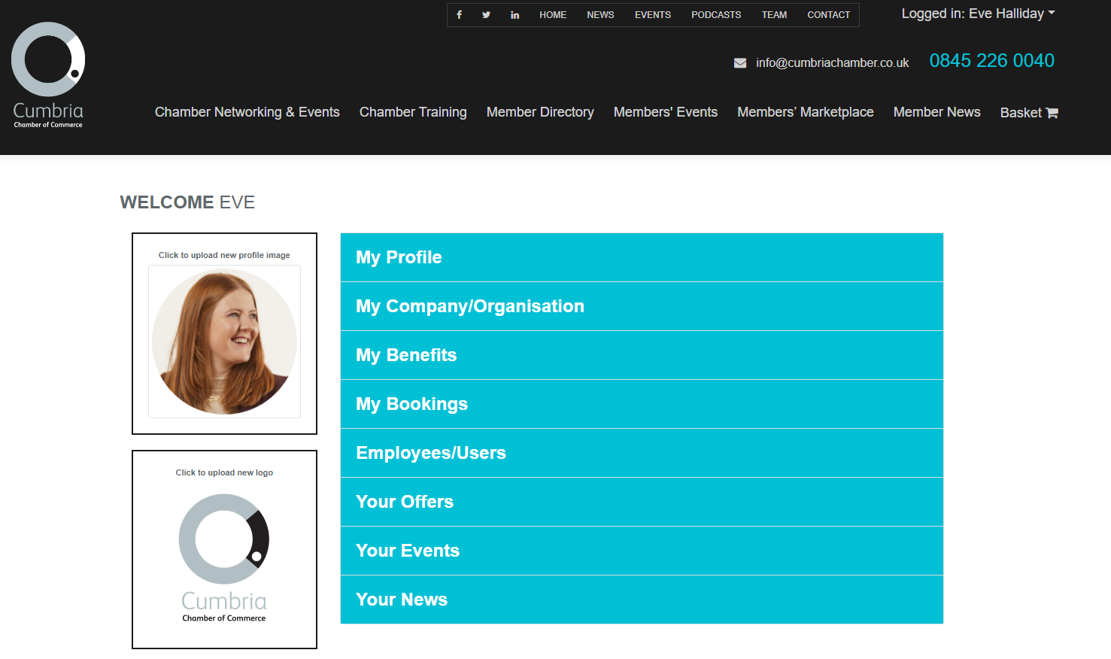
Chamber Member Portal

Slide 28
Events
&
Networking

Slide 29
Events & Networking
What do you need to know.
Business Bites is an ongoing success with monthly networking around the county.
Directors' Forum events are booked all year which are being pushed out to DF members.
Women in Business events are booked all year up until International Women’s Day 2024
North & South County Christmas Lunches are ready for members to book spaces.
Conference Cumbria ……
Notes:
Talk about:
A little bit about each group and how to get involved.

Slide 30
Events & Networking

Slide 31
Events & Networking
What do I need from you?
Attendance
How would you like to find out about events?
What sort of events would you like?
Policy events.

Slide 32
Questions

Slide 33
Where Business Belongs…

